Slide 1
Implementing virtual machines
Overview of Azure Resource Manager virtual machines
Planning for Azure virtual machines
Deploying Azure Resource Manager virtual machines
Authoring Azure Resource Manager templates
Overview of classic virtual machines

Slide 2
Overview of Azure Resource Manager virtual machines
resource - A manageable item that is available through Azure. Some common resources are a virtual machine, storage account, web app, database, and virtual network, but there are many more.
resource group - A container that holds related resources for an Azure solution. The resource group can include all the resources for the solution, or only those resources that you want to manage as a group. You decide how you want to allocate resources to resource groups based on what makes the most sense for your organization.
resource provider - A service that supplies the resources you can deploy and manage through Resource Manager. Each resource provider offers operations for working with the resources that are deployed. Some common resource providers are Microsoft.Compute, which supplies the virtual machine resource, Microsoft.Storage, which supplies the storage account resource, and Microsoft.Web, which supplies resources related to web apps.
Resource Manager template - A JavaScript Object Notation (JSON) file that defines one or more resources to deploy to a resource group. It also defines the dependencies between the deployed resources. The template can be used to deploy the resources consistently and repeatedly.
declarative syntax - Syntax that lets you state "Here is what I intend to create" without having to write the sequence of programming commands to create it. The Resource Manager template is an example of declarative syntax. In the file, you define the properties for the infrastructure to deploy to Azure.

Slide 3
Planning for Azure virtual machines
This diagram depicts the building blocks we need to have in place before connecting
Windows Azure Pack to Virtual Machine Manager in order to be able to provision
machines. We also need to configure some elements of Virtual Machine Manager and
make key decisions around the underlying fabric. As you can see Windows Azure
Pack uses Service Provider Foundation (SPF) in order to “talk” to VMM. SPF
provides a web based interface (ODATA) for Windows Azure Pack to send
commands.
First here is a quick checklist to help you complete each task so we don’t miss any steps
Provision VMM
Configure VMM with Hosts
Configure VMM Networking Configure VMM Templates
Configure VMM Clouds
Configure SPF Connect Windows Azure Pack

Slide 4
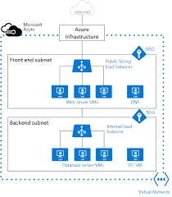

Slide 5
Deploying Azure Resource Manager virtual machines
Application Lifecycle Container
Declarative solution for Deployment and Configuration
Consistent Management Layer
Resource Groups
Tightly coupled containers of multiple resources of similar or different types
Every resource *must* exist in one and only one resource group
Resource groups can span regions
RESOU
R
CE G
R
OUP

Slide 6
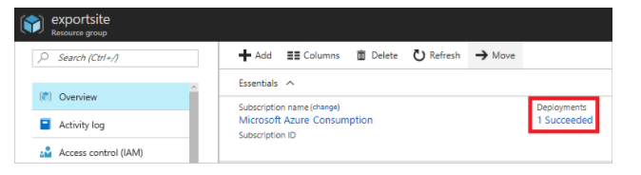
Authoring Azure Resource Manager templates
View template from deployment history
Go to the resource group blade for your new resource group. Notice that the blade shows the result of the last deployment. Select this link.

Slide 7
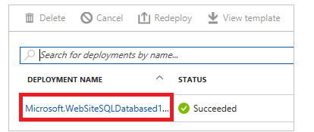
You see a history of deployments for the group. In your case, the blade probably lists only one deployment. Select this deployment.
The blade displays a summary of the deployment. The summary includes the status of the deployment and its operations and the values that you provided for parameters. To see the template that you used for the deployment, select View template.

Slide 8
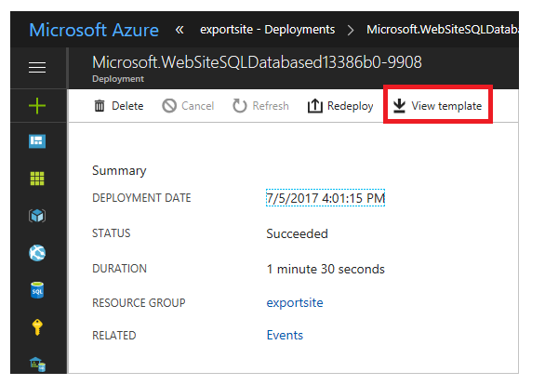

Slide 9
Resource Manager retrieves the following seven files for you:
Template - The template that defines the infrastructure for your solution. When you created the storage account through the portal, Resource Manager used a template to deploy it and saved that template for future reference.
Parameters - A parameter file that you can use to pass in values during deployment. It contains the values that you provided during the first deployment. You can change any of these values when you redeploy the template.
CLI - An Azure command-line-interface (CLI) script file that you can use to deploy the template.
CLI 2.0 - An Azure command-line-interface (CLI) script file that you can use to deploy the template.
PowerShell - An Azure PowerShell script file that you can use to deploy the template.
.NET - A .NET class that you can use to deploy the template.
Ruby - A Ruby class that you can use to deploy the template.
The files are available through links across the blade. By default, the blade displays the template.
This template is the actual template used to create your web app and SQL database. Notice it contains parameters that enable you to provide different values during deployment. To learn more about the structure of a template

Slide 10
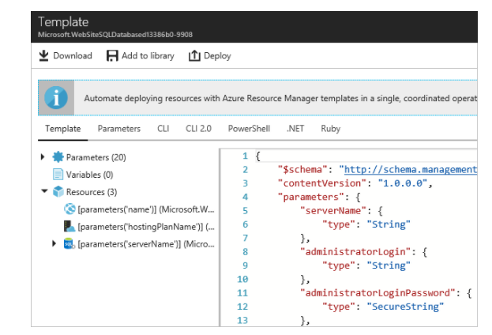

Slide 11
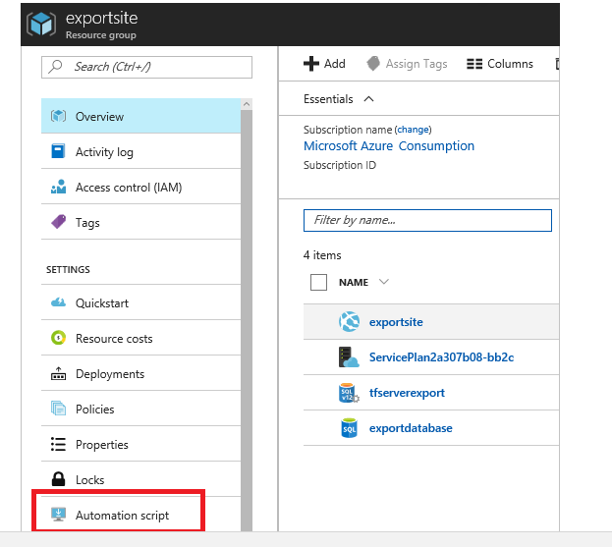
Export the template from resource group
If you have manually changed your resources or added resources in multiple deployments, retrieving a template from the deployment history does not reflect the current state of the resource group. This section shows you how to export a template that reflects the current state of the resource group. 1.To view the template for a resource group, select Automation script.
Resource Manager evaluates the resources in the resource group, and generates a template for those resources. Not all resource types support the export template function. You may see an error stating that there is a problem with the export.

Slide 12
You again see the six files that you can use to redeploy the solution. However, this time the template is a little different. Notice that the generated template contains fewer parameters than the template in previous section. Also, many of the values (like location and SKU values) are hard-coded in this template rather than accepting a parameter value. Before reusing this template, you might want to edit the template to make better use of parameters.
You have a couple of options for continuing to work with this template. You can either download the template and work on it locally with a JSON editor. Or, you can save the template to your library and work on it through the portal.
If you are comfortable using a JSON editor like VS Code or Visual Studio, you might prefer downloading the template locally and using that editor. To work locally, select Download.
If you are not set up with a JSON editor, you might prefer editing the template through the portal. The remainder of this topic assumes you have saved the template to your library in the portal. However, you make the same syntax changes to the template whether working locally with a JSON editor or through the portal. To work through the portal, select Add to library.
When adding a template to the library, give the template a name and description. Then, select Save.

Slide 13
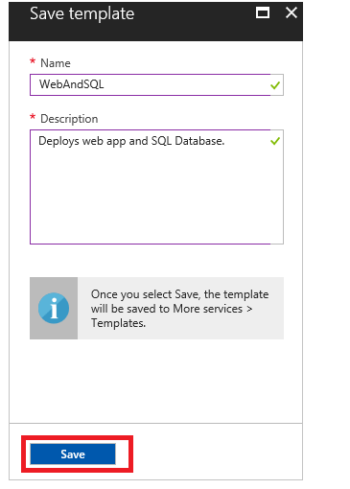

Slide 14
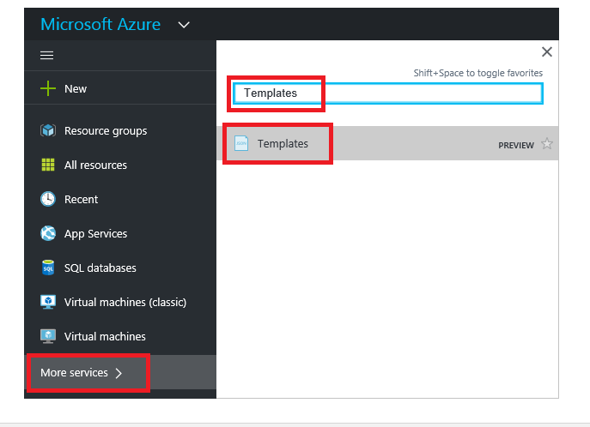
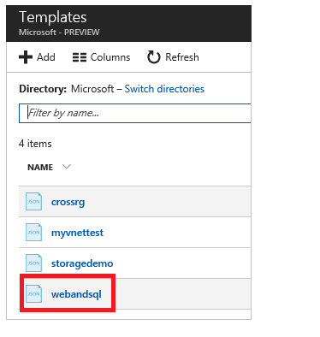
To view a template saved in your library, select More services, type Templates to filter results, select Templates.
Select the template with the name you saved.

Slide 15
Overview of classic virtual machines
Use a classic virtual system pattern to rapidly set up and manage your cloud middleware topology. A classic
virtual system pattern describes a middleware topology and employs the tools to automatically build that
topology in the cloud.
Classic virtual system patterns are focused on the middleware layers of the system by defining repeatable,
deployable topologies that can be shared. The fundamental building blocks of classic virtual system patterns
are parts that are delivered with virtual images. These parts, together with configuration parameters and
other artifacts such as script packages and add-ons, are used to create complex patterns that are deployed
as a single unit.
Classic virtual system patterns are the captured essence of years of infrastructure-management experience
and best practices. Classic virtual system patterns encapsulate repeatable topology definitions that are based
on various middleware images and runtime configurations; they give you control over the middleware
landscape that is deployed.

